Slide 1

KQL and Azure AD Workbooks for the Blue Team

Slide 2

Speaker Bio
Corissa Koopmans
Her/She
Product Manager Identity Network & Access Management
CoKoopma@microsoft.com

Slide 3
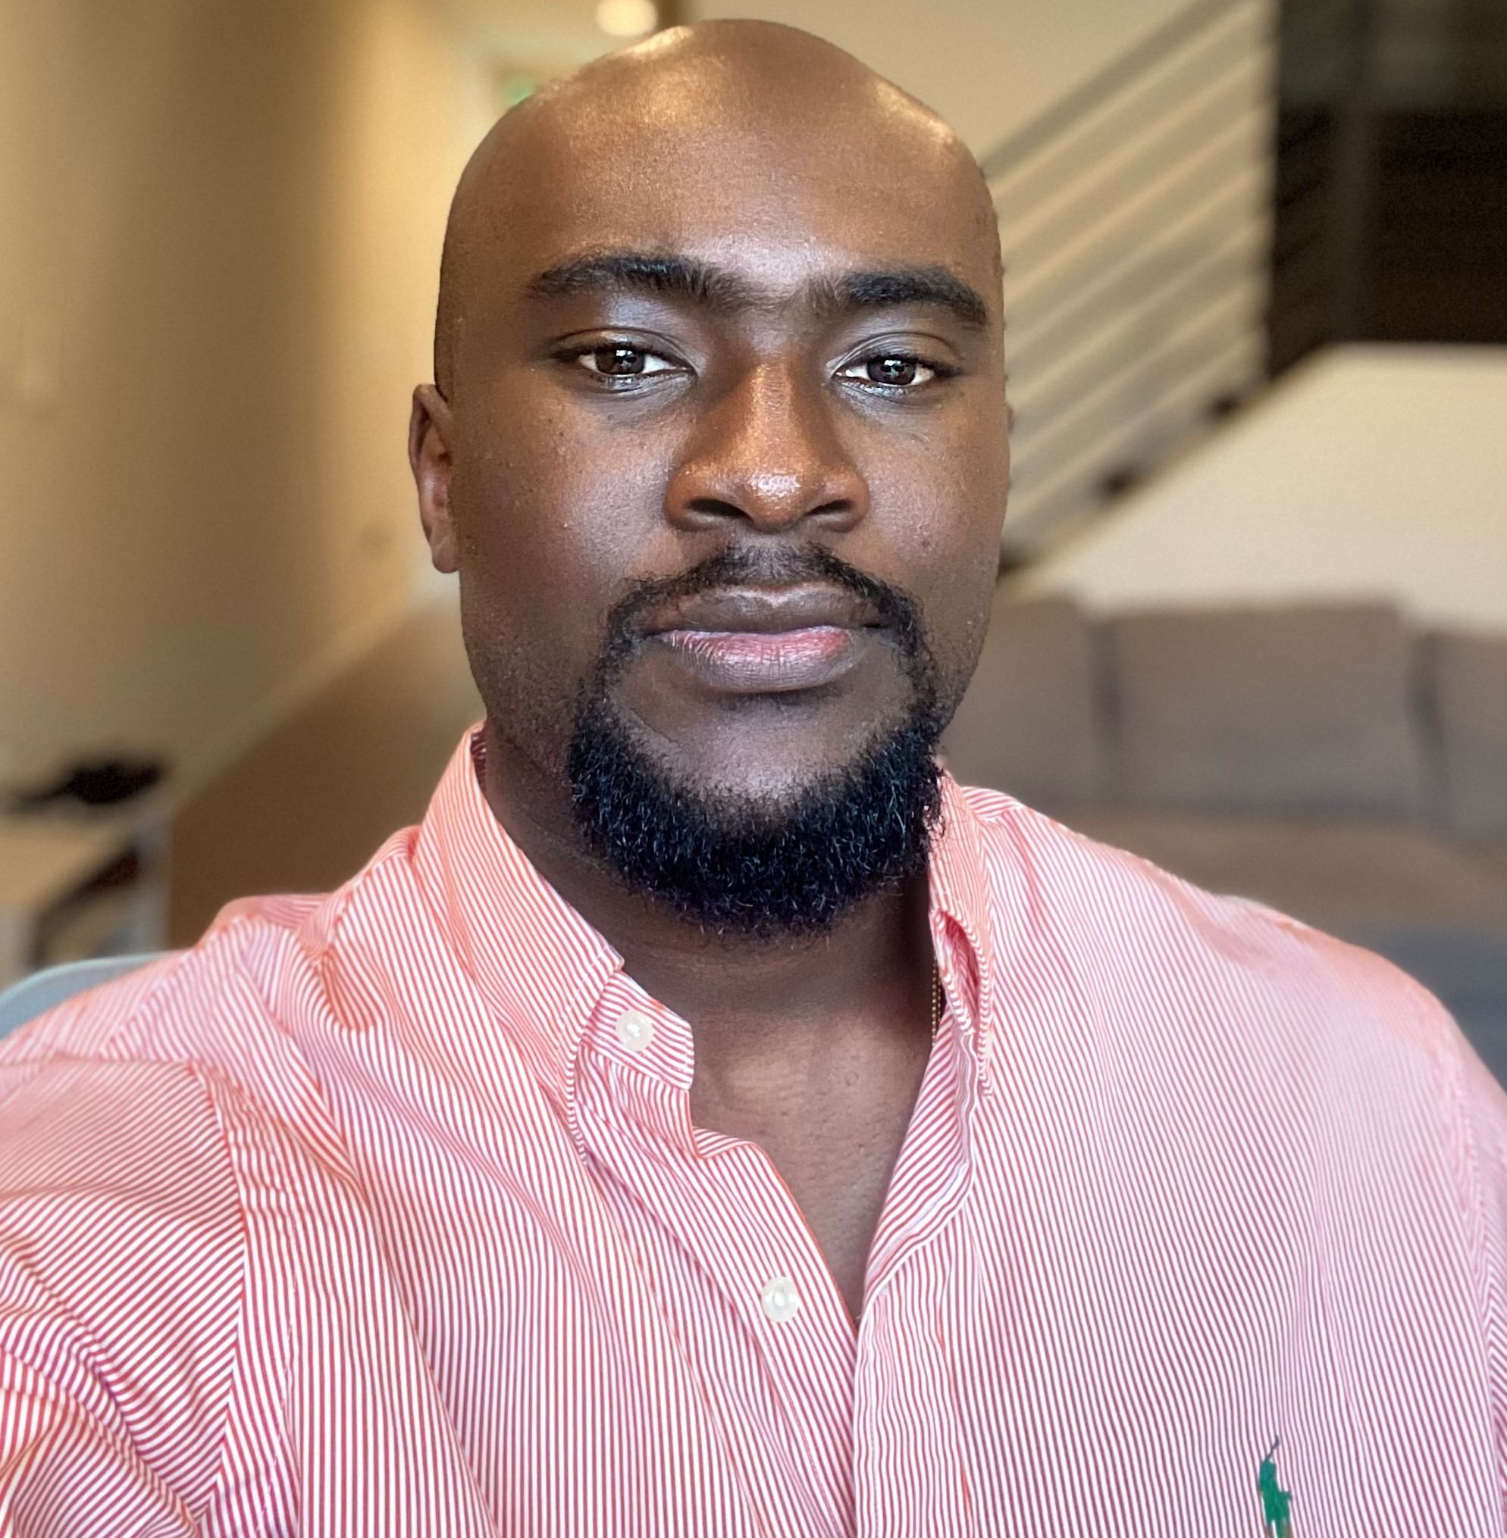
Speaker Bio
Tosin Lufadeju
He/Him
Product Manager Identity Network & Access Management
Tolufade@microsoft.com

Slide 4
Session Learning Objective
The objective of this session is to share threat hunting techniques using KQL and Azure AD Workbooks.
Notes:
Do Not Delete. Do Not Change.

Slide 5
Agenda
Quick overview of workbooks
Business cases for the Blue Team
Threat hunting with KQL/Tips and Tricks
Community Contribution

Slide 6

Zero Trust: Real-time automated threat protection
Classify, label, encrypt
Data
Identities
Organization policy
Multi-factor authentication
Adaptive access
Apps
User/session risk
Security policy enforcement
Real-time policy evaluation
Device risk state
Access and runtime control
Infrastructure
Device inventory
Devices/ Endpoints
Threat protection
Threat intelligence
Visibility and Analytics
Network
Automation
Notes:
A holistic approach to Zero Trust approach should extend throughout the entire digital estate—
Visibility, Analytics, and Automation: Telemetry from the systems above must be processed and acted on automatically. Attacks happen at cloud speed – your defense systems must act at cloud speed as well, and humans just can’t react quickly enough. Integrate intelligence with policy-based response for real-time automated threat protection.

Slide 7
What are workbooks?
Workbooks is a visualization tool available in the Azure Portal. It allows you combine multiple data sources to produce a single interactive report.
Common Data Sources:
Logs (Azure Monitor Logs, Resource-centric logs)
Azure Resource Graph
Azure Data Explorer
Workload Health
Custom Endpoints (For external sources)
If you have O365, you have Azure AD and this is an easy way to start exploring workbooks

Slide 8
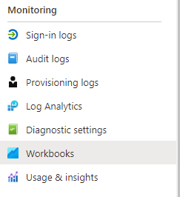



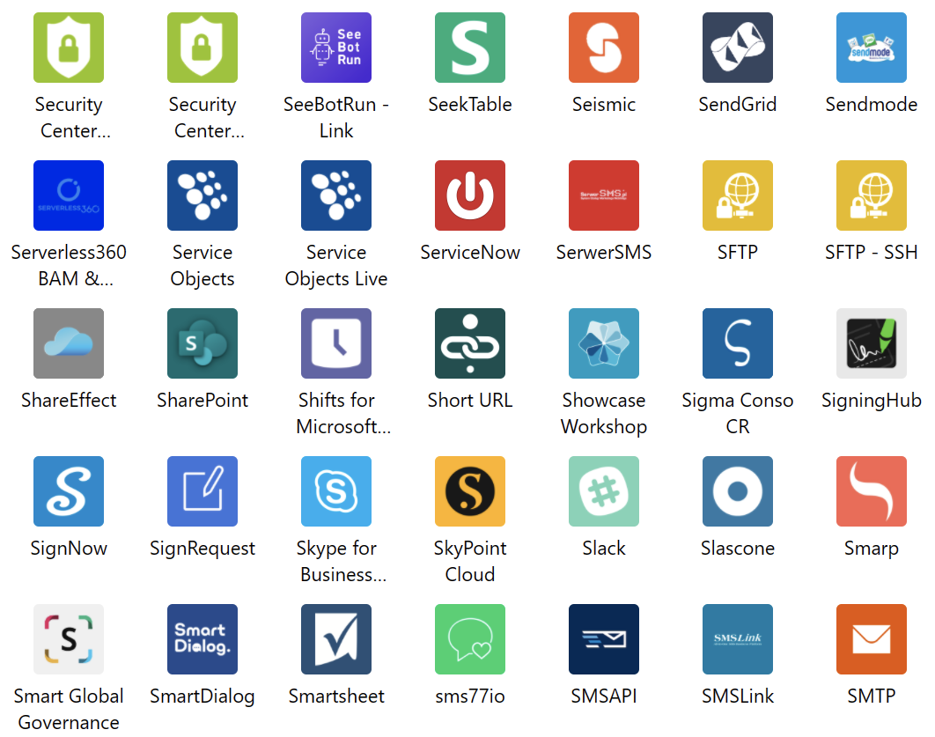





Visibility and Analytics
Out-of-box capabilities
Advanced capabilities
Automation
Azure Overview
Sign-in logs
Conditional Access Insights and Reporting
Conditional Access Overview
Identity Secure Score
Pre-built Workbooks
Provisioning Logs
Auth Methods Registration dashboard
3rd party export integrations
SIEM and SOAR integrations
Export data settings
Low code No code integration
Extensibility
Log Analytics
Azure Sentinel
Logic Apps
Azure Monitor

Slide 9
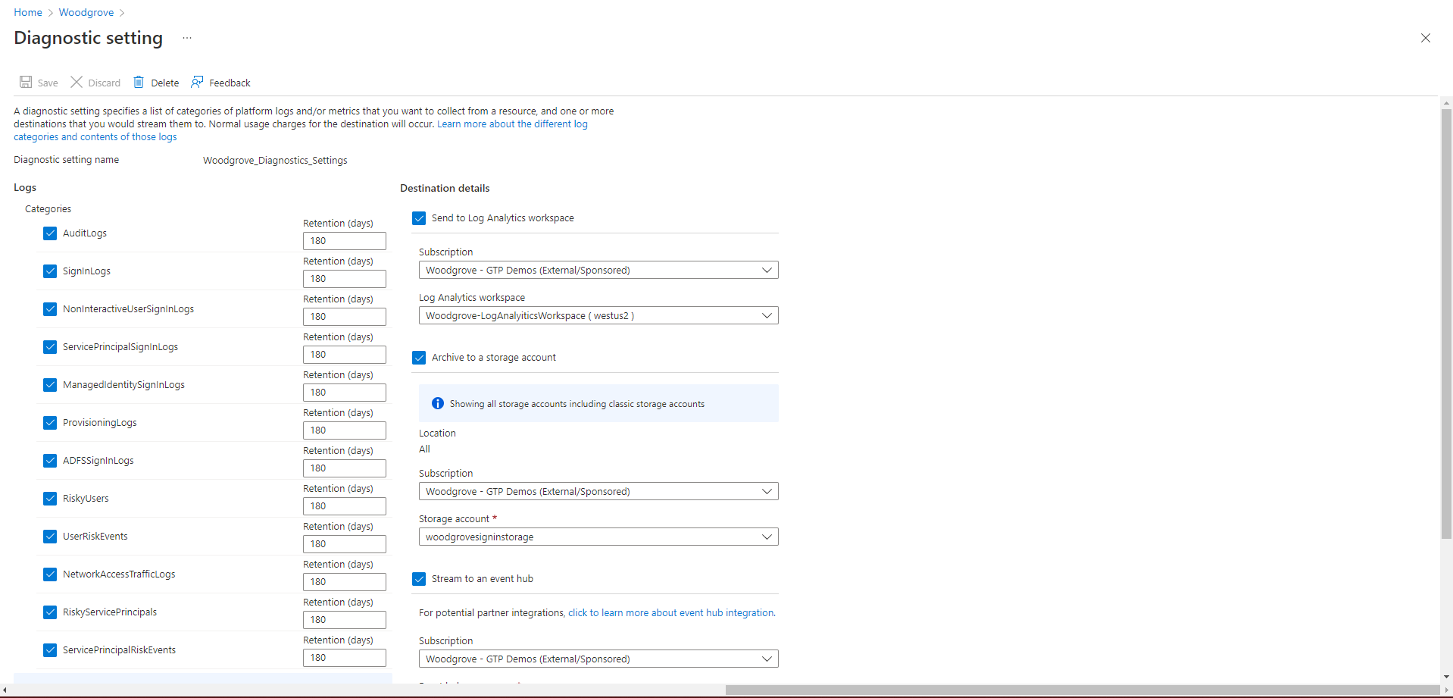
Prerequisite to use AzureAD workbooks​
Diagnostic settings
This is needed to export logs to third party apps like Splunk, ArcSight, SumoLogic etc.​

Slide 10
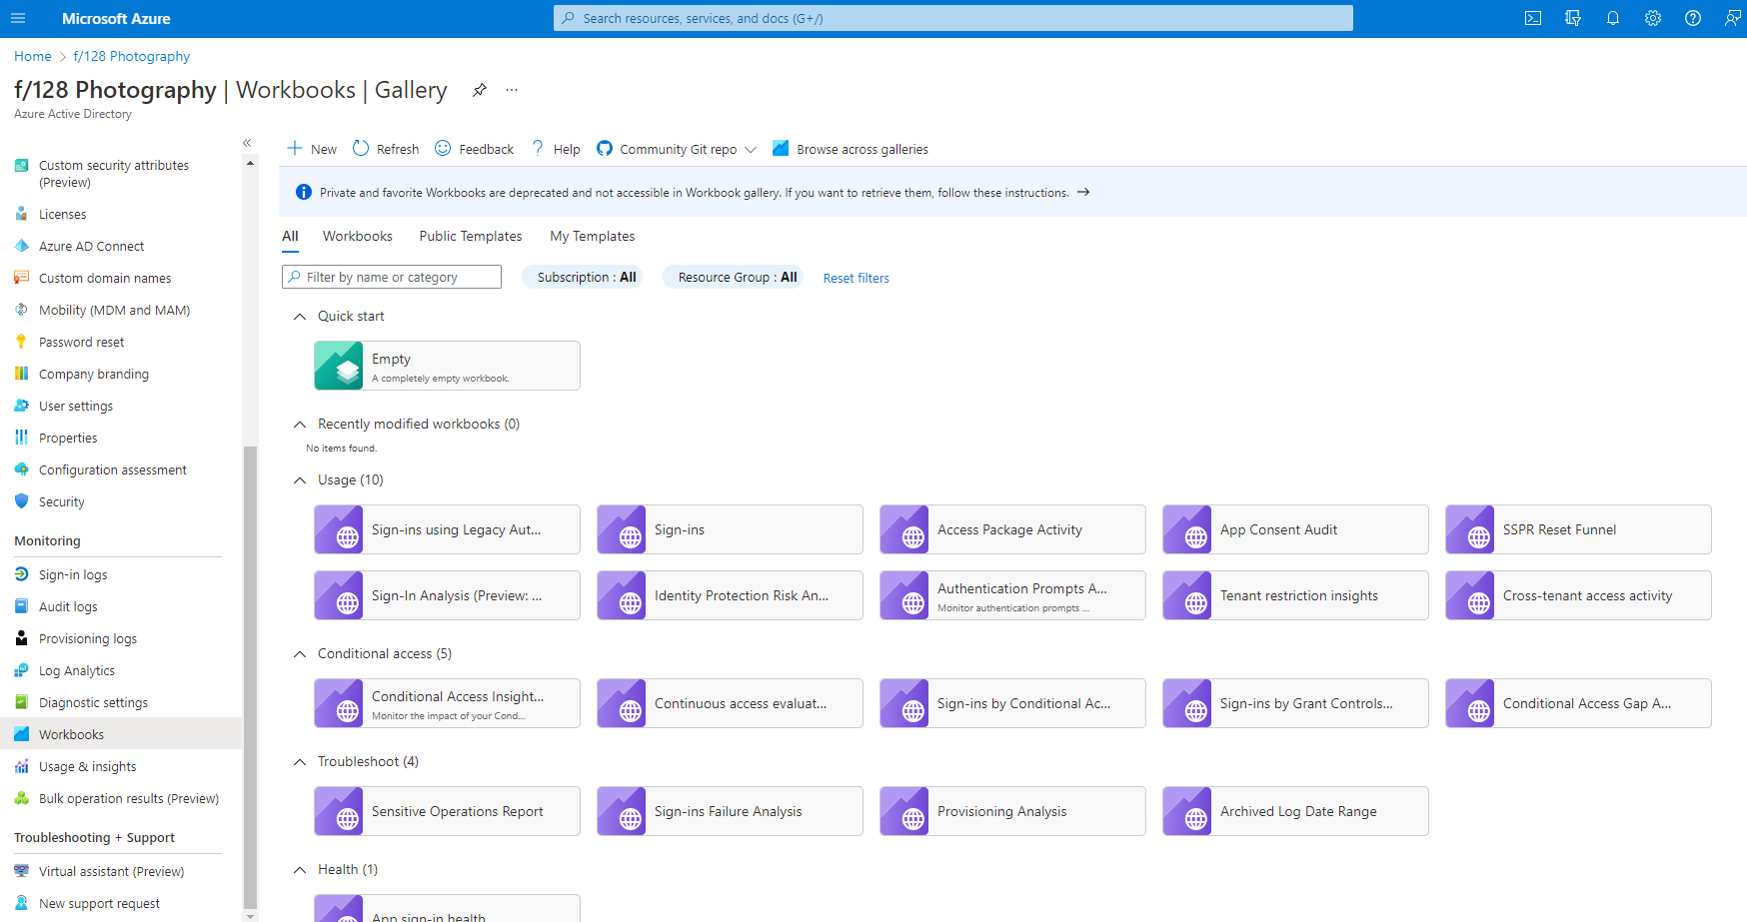
Azure AD Workbooks overview
Create a new workbook.
Discover workbooks with tabs and search.
Open a workbook template; use it as–is or edit it to suit your needs.
Set up data to flow into Log Analytics.
Browse workbook templates in the Azure AD Workbooks gallery.

Slide 11
Business Cases

Slide 12
Business Use Cases
Monitor changes in app permissions and role changes
Alert on modified federation settings
Identify high risk events and users in your environment
Detect suspicious cross-tenant activity
Discover gaps in security posture
Uncover sign-ins using legacy authentication

Slide 13
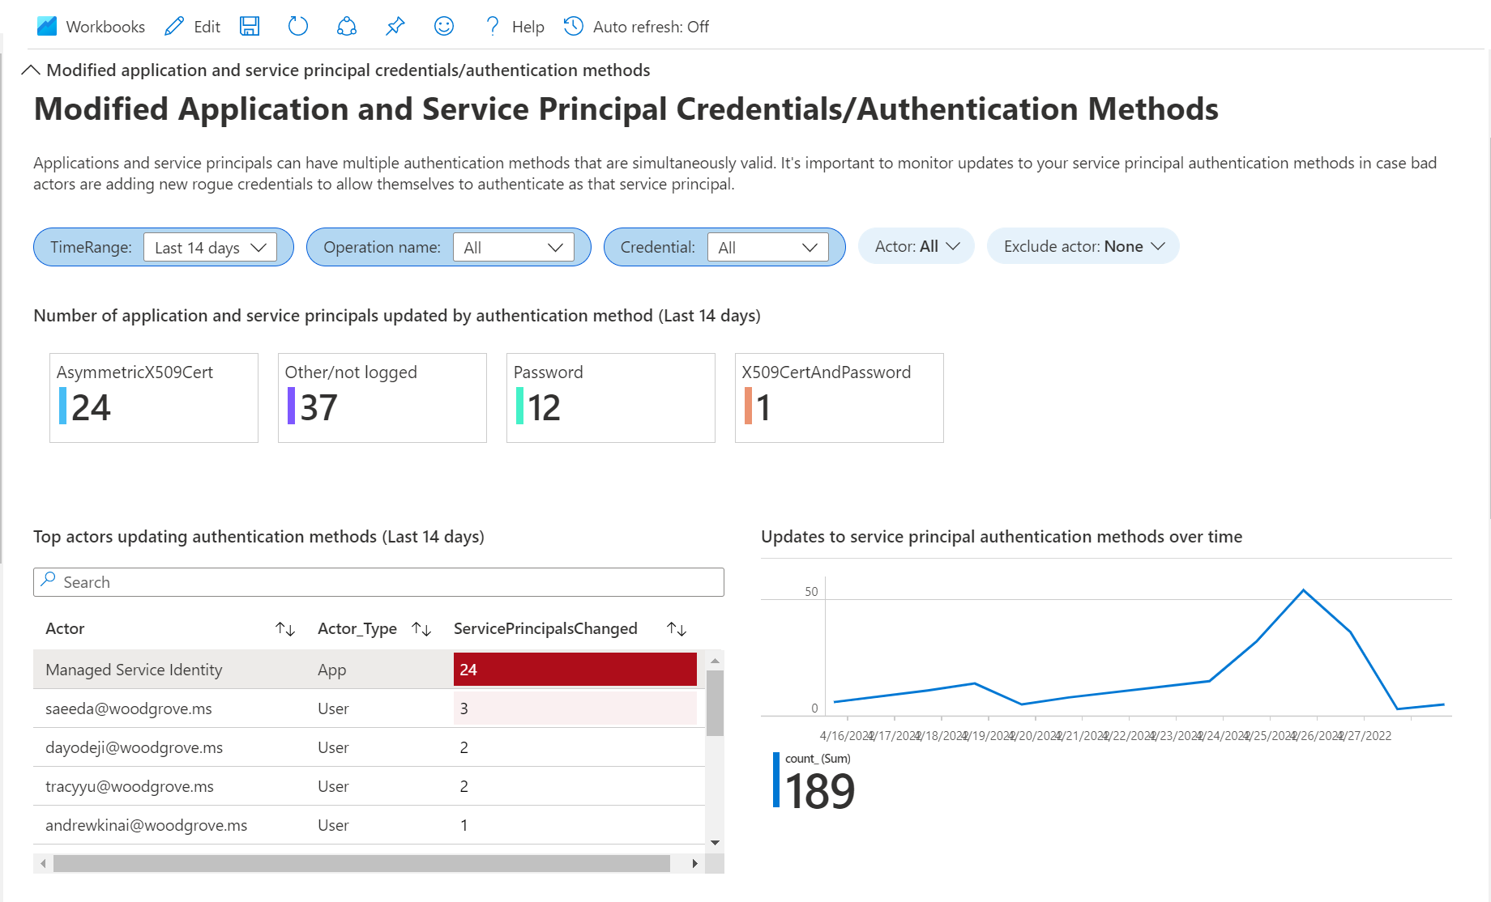
Security Operations Report
Notes:
Service principals can have different auth methods.
Allows you monitor when a change is made to a service principals authentication method.
Bad actors can take advantage of these to grant access to themselves as that SP

Slide 14
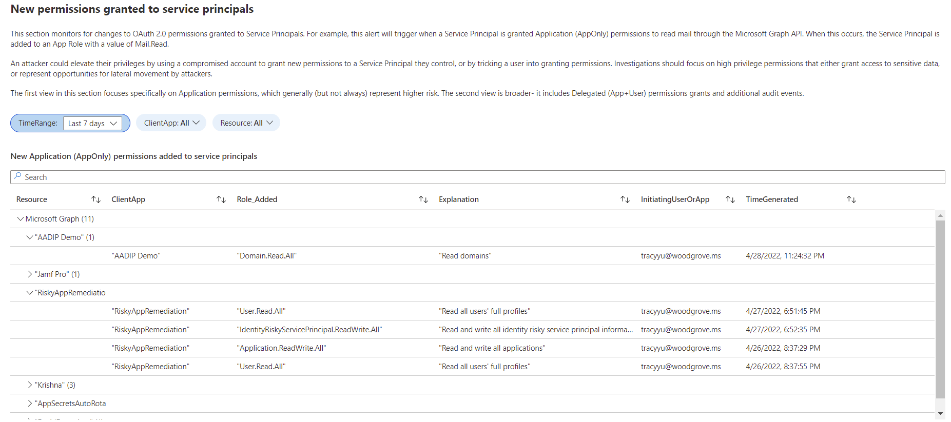
Security Operations Report

Slide 15
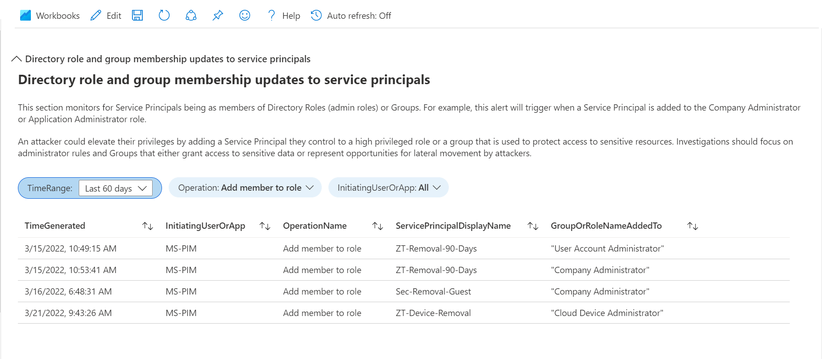
Security Operations Report
Notes:
An attacker could elevate their privileges by adding a Service Principal they control to a high privileged role or a group.
This should trigger an alert for roles that have access to sensitive data

Slide 16
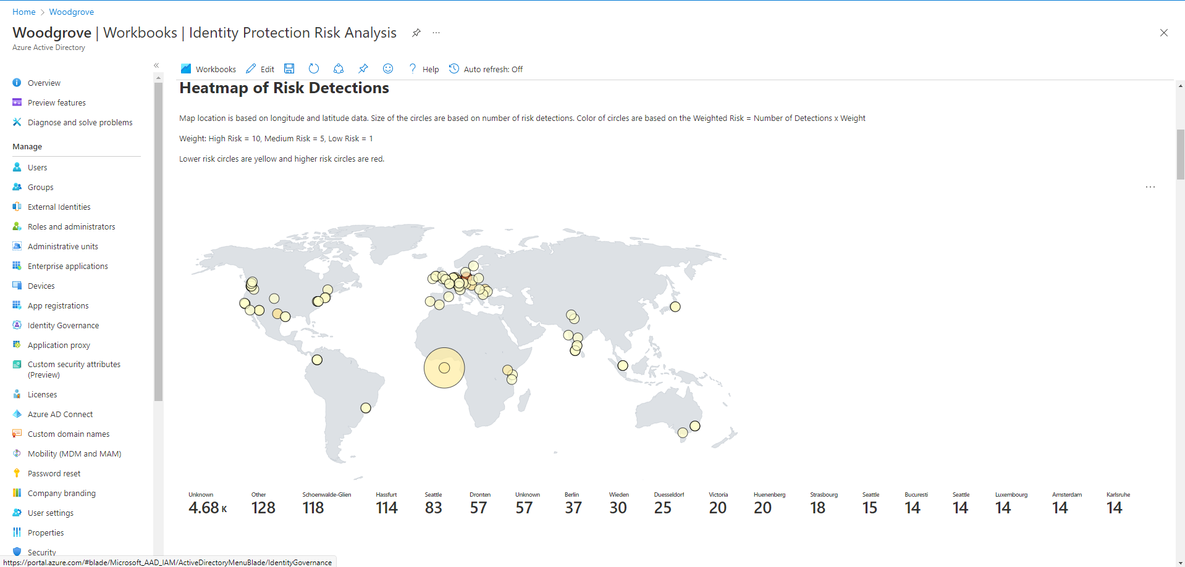
Risk Event Analysis
Notes:
With Identity Protection configured, customers want to have a quick view into where their risk events are coming from
Quick way to see those
Read means high, Yellow low
Circle size indicates higher count

Slide 17
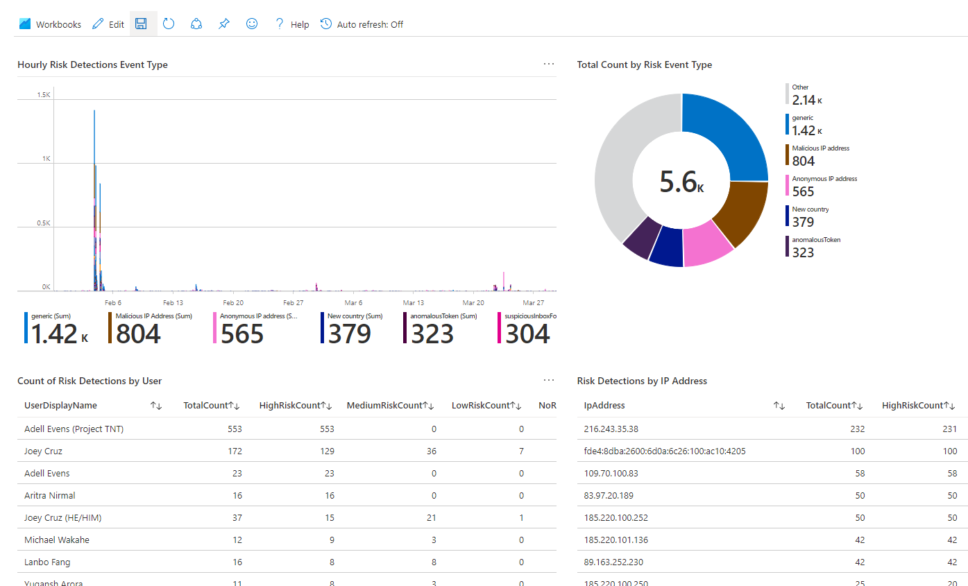
Risk Event Analysis

Slide 18
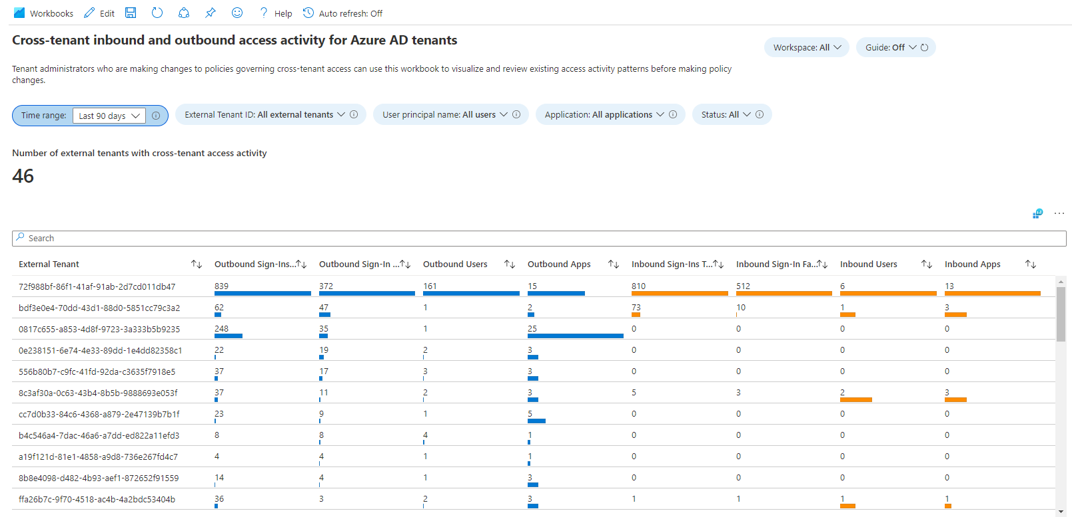
Cross Tenant Activity Tracking

Slide 19
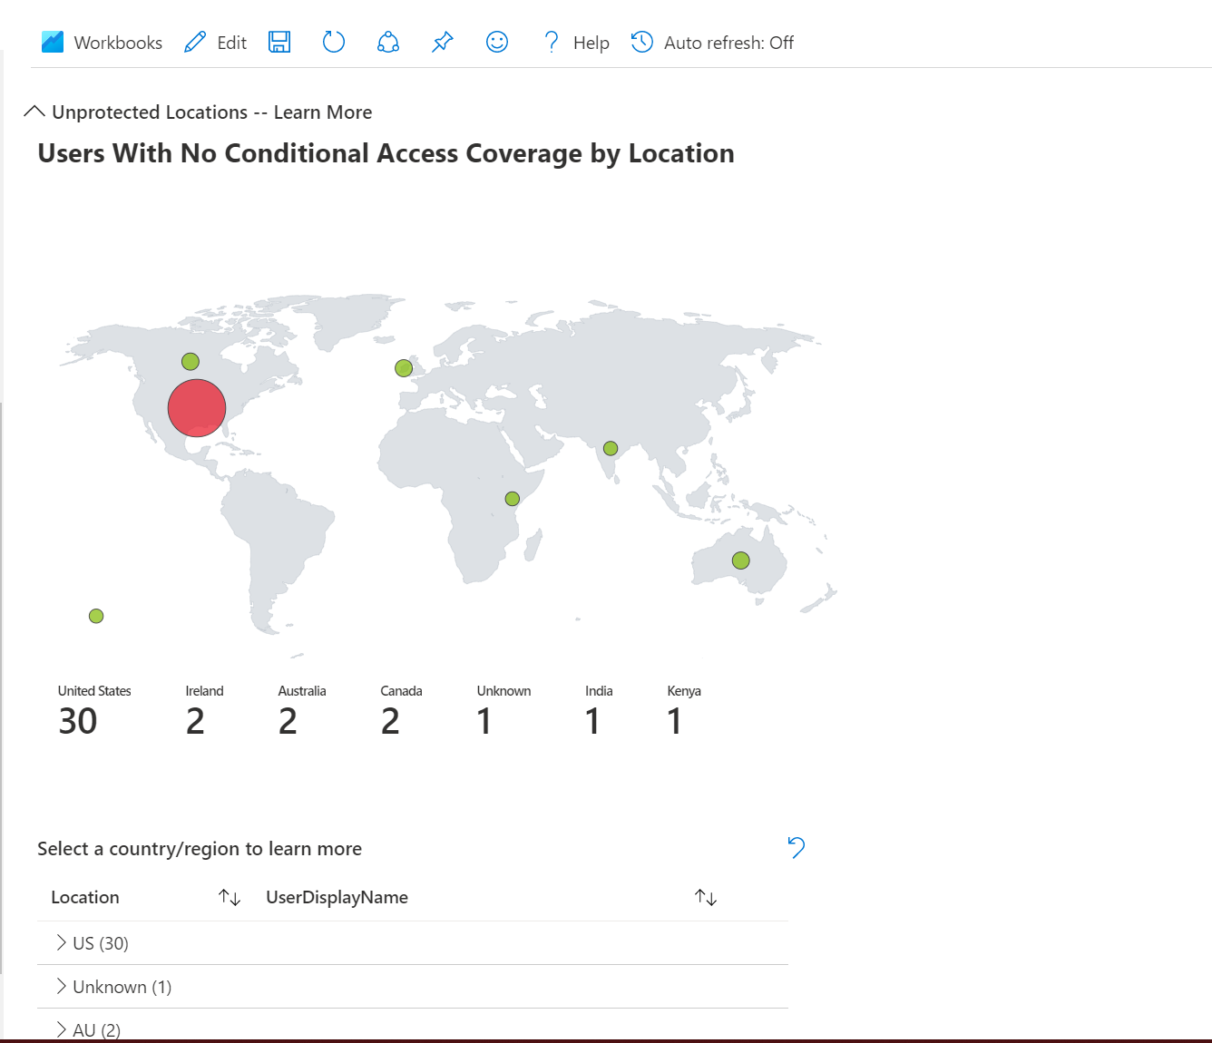
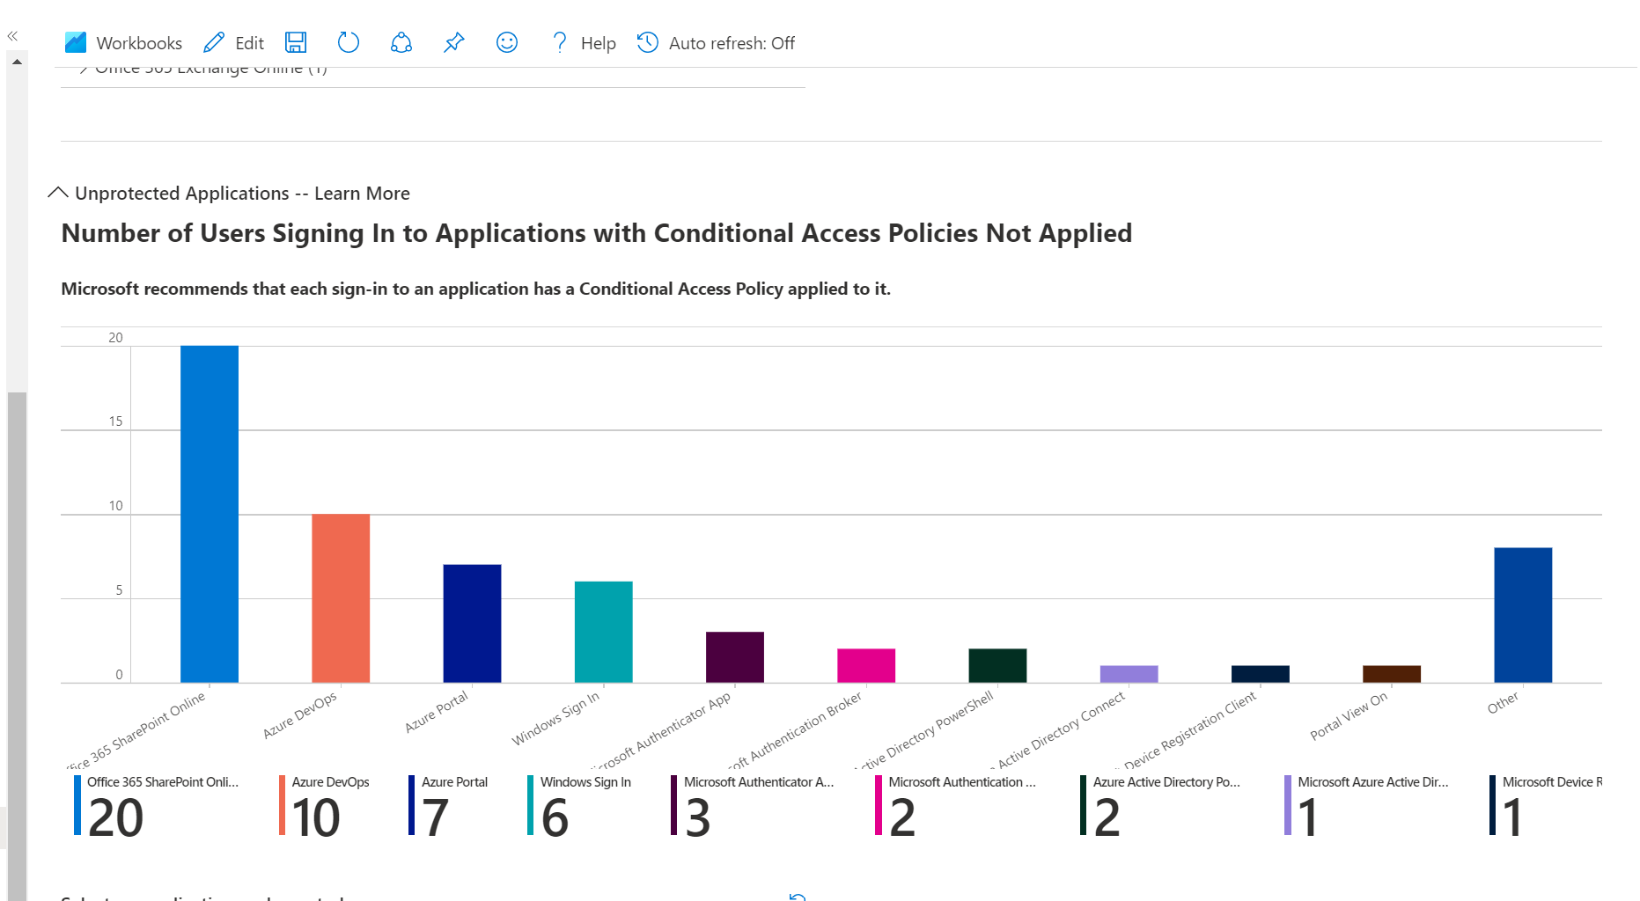
Gap Analyzer
CA Gap Analyzer

Slide 20
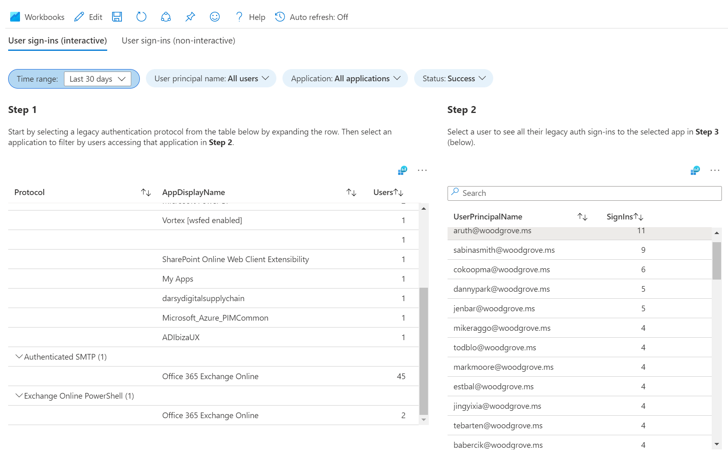
Can filter your logs based off the interactivity of the attempt. ​
Sign-ins using legacy authentication
Notes:
October 1, 2022, we will begin disabling Basic authentication for Outlook, EWS, RPS, POP, IMAP, and EAS protocols in Exchange Online.

Slide 21

Threat Hunting with KQL and Log Analytics
Notes:
Now we are going to dive in a bit more on how to make the most of these workbooks.

Slide 22
Create alerts for high-risk activities
Administrator Fail MFA

Slide 23
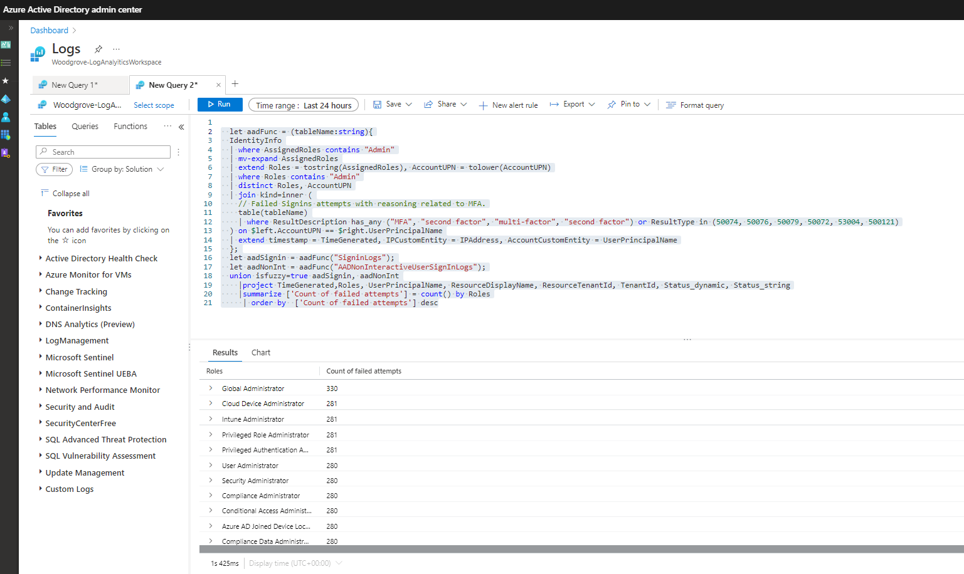

Slide 24
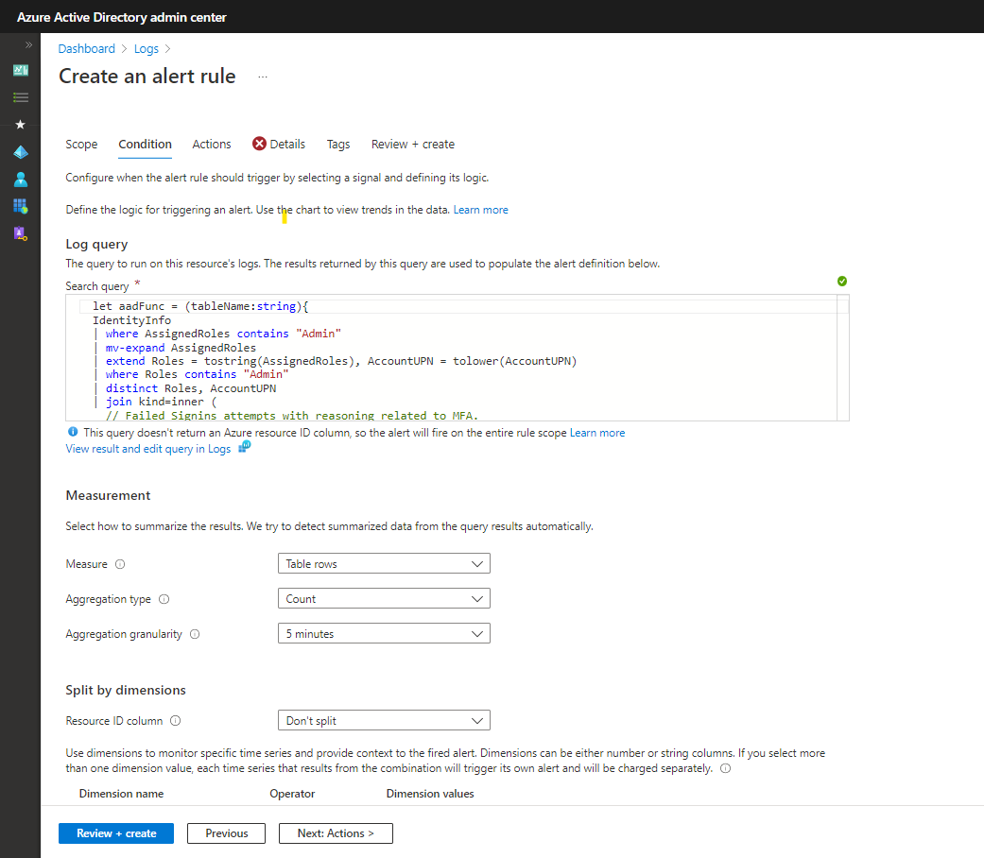
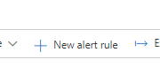

Slide 25
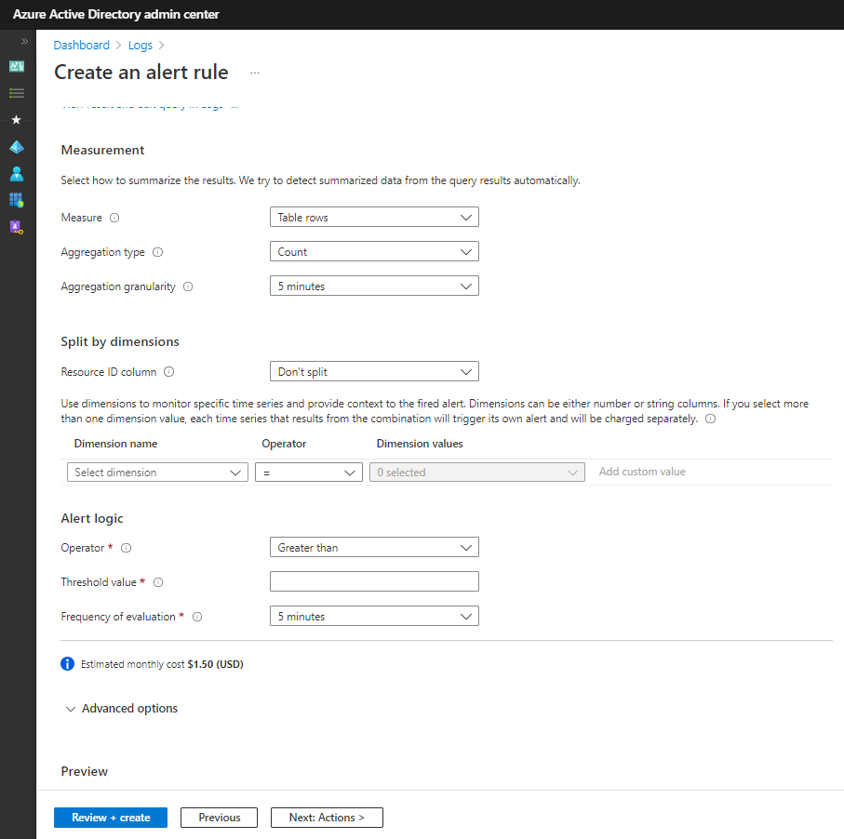

Slide 26
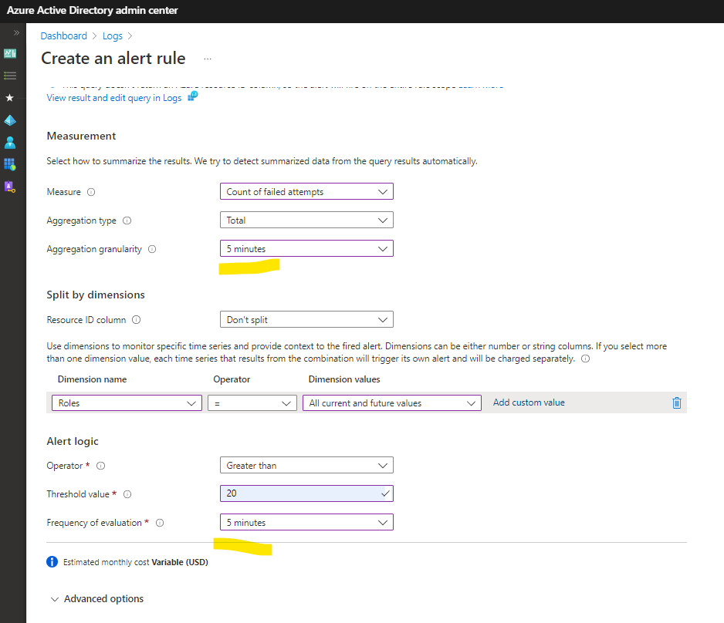

Slide 27
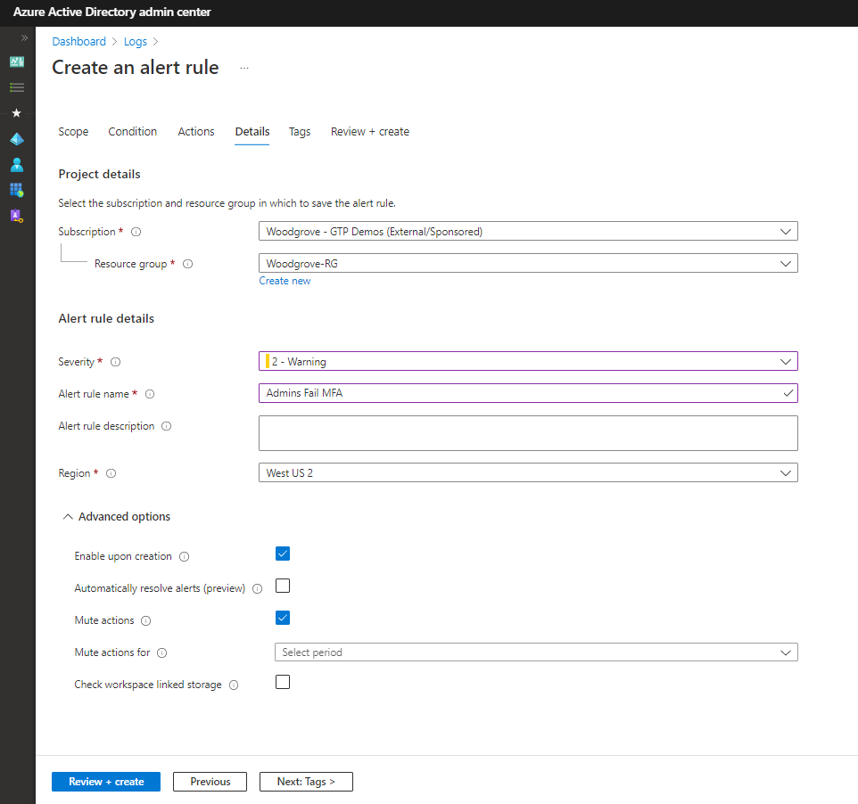

Slide 28
Administrators Fails MFA
let aadFunc = (tableName:string){
IdentityInfo
| where AssignedRoles contains "Admin"
| mv-expand AssignedRoles
| extend Roles = tostring(AssignedRoles), AccountUPN = tolower(AccountUPN)
| where Roles contains "Admin"
| distinct Roles, AccountUPN
| join kind=inner (
// Failed Signins attempts with reasoning related to MFA.
table(tableName)
| where ResultDescription has_any ("MFA", "second factor", "multi-factor", "second factor") or ResultType in (50074, 50076, 50079, 50072, 53004, 500121)
) on $left.AccountUPN == $right.UserPrincipalName
| extend timestamp = TimeGenerated, IPCustomEntity = IPAddress, AccountCustomEntity = UserPrincipalName
};
let aadSignin = aadFunc("SigninLogs");
let aadNonInt = aadFunc("AADNonInteractiveUserSignInLogs");
union isfuzzy=true aadSignin, aadNonInt
|project TimeGenerated,Roles, UserPrincipalName, ResourceDisplayName, ResourceTenantId, TenantId, Status_dynamic, Status_string
|summarize ['Count of failed attempts'] = count() by Roles
| order by ['Count of failed attempts'] desc

Slide 29
Tips and Tricks KQL

Slide 30
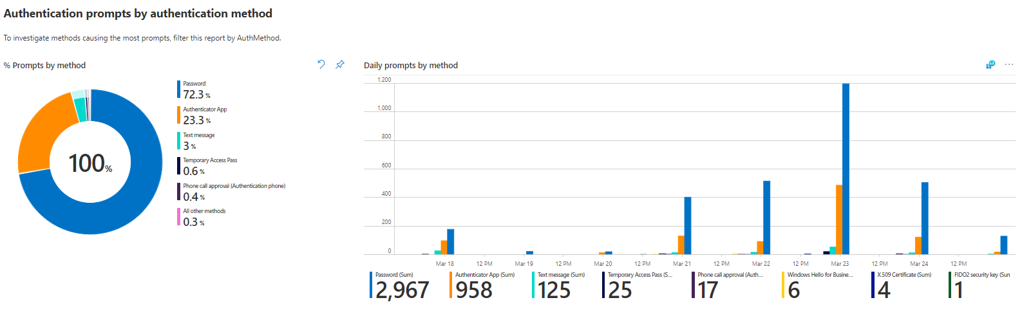
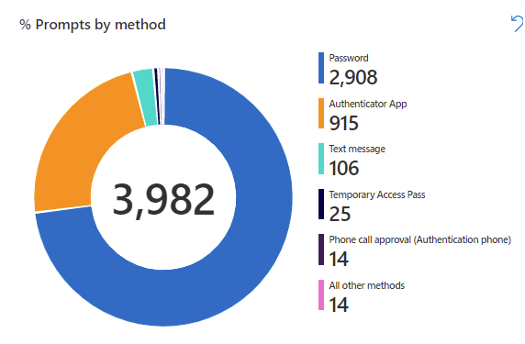
Laying out your workbook

Slide 31
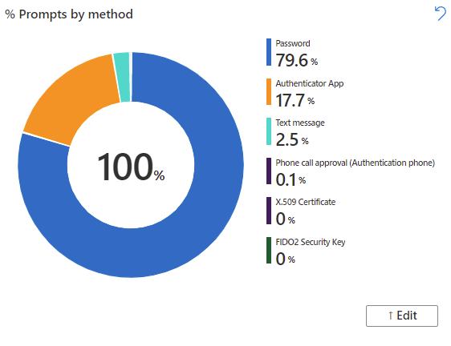
Converting count to percentages

Slide 32
Base query
SigninLogs
|mv-expand ParsedFields=parse_json(AuthenticationDetails) //parse out Authentication Details column and put in new column called “ParsedFields”
|extend AuthenticationMethod = ParsedFields.authenticationMethod //create new column by extracting the authenticationMethod value out of the ParsedFields column
|extend AuthMethod = tostring(AuthenticationMethod) //convert to string format
|extend ParsedFields2=parse_json(DeviceDetail) //parse out Device Details column and put in column called “ParsedFields2”
|extend DeviceState = case(DeviceDetail["trustType"] == "", "Unmanaged", DeviceDetail["trustType"]) //convert to string
|extend OperatingSystem = ParsedFields2.operatingSystem //extract the operatingSystem value out of the ParsedFields2 column
|extend OS = tostring(OperatingSystem) //convert to string format
|where AuthMethod != "Previously satisfied" and AuthMethod != "“ //remove Previously Satisfied and blank AuthMethods from the query
|where UserDisplayName != "On-Premises Directory Synchronization Service Account“ //remove this UserDisplayDname
|where AuthMethod in ({AuthMethod}) or '*' in ({AuthMethod}) //AuthMethod parameter
|where DeviceState in ({DeviceState}) or '*' in ({DeviceState}) //DeviceState parameter
|where "{User:escape}" == "All users" or UserDisplayName contains "{User:escape}“ //User parameter
|where "{App:escape}" == "All apps" or AppDisplayName contains "{App:escape}“ //App parameter
|where "{OS:escape}" == "All OS" or OS contains "{OS:escape}“ //OS parameter
|extend Status = ParsedFields.succeeded //extract the succeeded valueout of the ParsedFields2 column
|extend AuthStatus = case(Status == "true", "Success", "Failure") //label status as Success or Failure
|where AuthStatus in ({AuthStatus}) or '*' in ({AuthStatus}) //AuthStatus parameter
|summarize Count = count() by AuthMethod //summarize operator aggregates data and produces count by AuthMethod

Slide 33
Percentage
let baseQuery = //store a dataset in baseQuery
materialize(SigninLogs //materialize creates a subquery that other queries can reference
|mv-expand ParsedFields=parse_json(AuthenticationDetails) //parse out Authentication Details column and put in new column called “ParsedFields”
|extend AuthenticationMethod = ParsedFields.authenticationMethod //create new column by extracting the authenticationMethod value out of the ParsedFields column
|extend AuthMethod = tostring(AuthenticationMethod) //convert to string format
|extend ParsedFields2=parse_json(DeviceDetail) //parse out Device Details column and put in column called “ParsedFields2”
|extend DeviceState = case(DeviceDetail["trustType"] == "", "Unmanaged", DeviceDetail["trustType"]) //convert to string
|extend OperatingSystem = ParsedFields2.operatingSystem //extract the operatingSystem value out of the ParsedFields2 column
|extend OS = tostring(OperatingSystem) //convert to string format
|where AuthMethod != "Previously satisfied" and AuthMethod != "“ //remove Previously Satisfied and blank AuthMethods from the query
|where UserDisplayName != "On-Premises Directory Synchronization Service Account“ //remove this UserDisplayDname
|where AuthMethod in ({AuthMethod}) or '*' in ({AuthMethod}) //AuthMethod parameter
|where DeviceState in ({DeviceState}) or '*' in ({DeviceState}) //DeviceState parameter
|where "{User:escape}" == "All users" or UserDisplayName contains "{User:escape}“ //User parameter
|where "{App:escape}" == "All apps" or AppDisplayName contains "{App:escape}“ //App parameter
|where "{OS:escape}" == "All OS" or OS contains "{OS:escape}“ //OS parameter
|extend Status = ParsedFields.succeeded //extract the succeeded valueout of the ParsedFields2 column
|extend AuthStatus = case(Status == "true", "Success", "Failure") //label status as Success or Failure
|where AuthStatus in ({AuthStatus}) or '*' in ({AuthStatus}) //AuthStatus parameter
);
let totalCount = toscalar(baseQuery | count); //return a scalar constant value of the evaluated expression
baseQuery //reference the baseQuery
|summarize Count = count(AuthMethod) * 100.0 /totalCount by AuthMethod //aggregate count, divide by total count

Slide 34
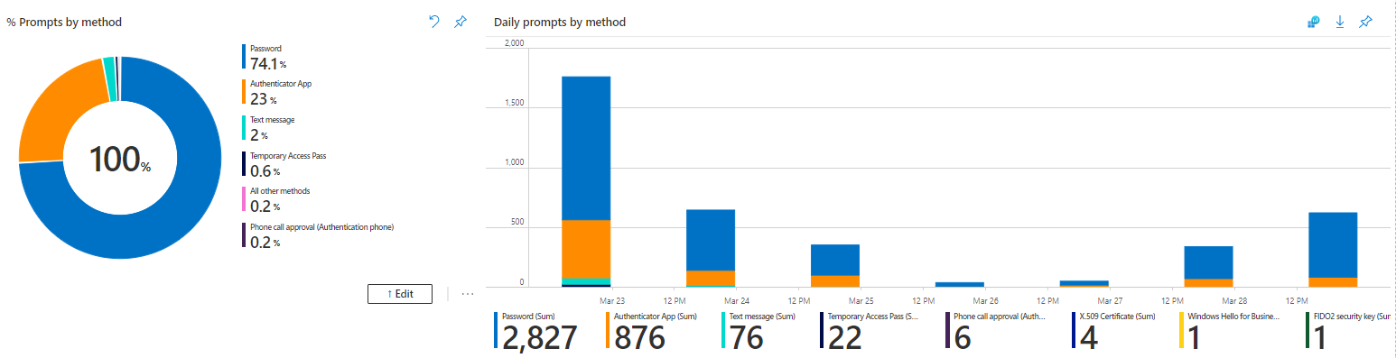
Interactive Graphs

Slide 35
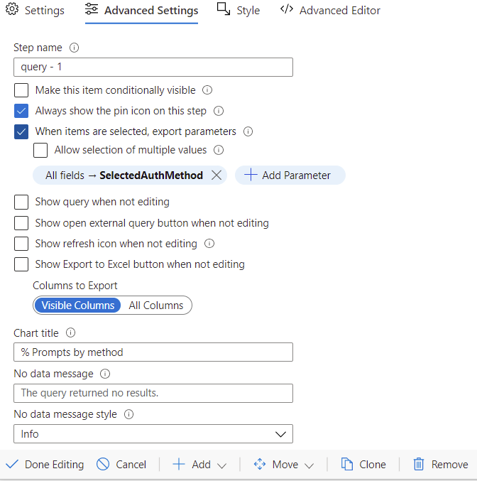
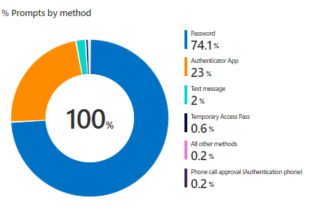
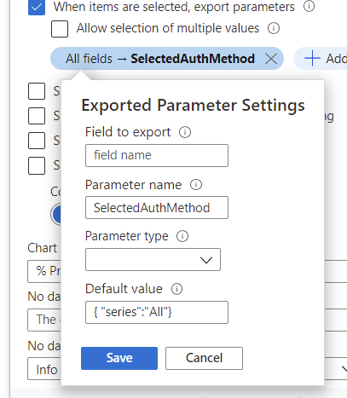
Interactive graphs

Slide 36
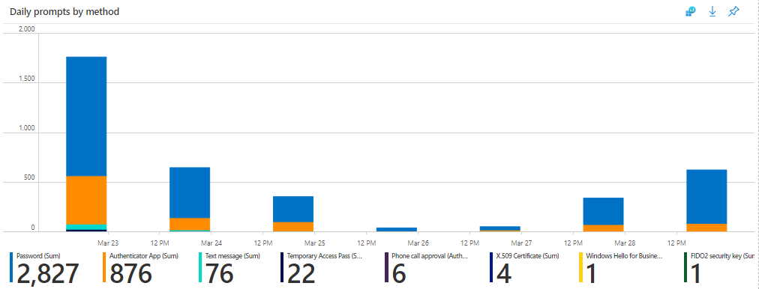
Interactive graphs
|mv-expand ParsedMethod = parse_json(tostring('{SelectedAuthMethod}'))
|extend SelectedAuthMethod = ParsedMethod.series
|where SelectedAuthMethod == 'All' or (AuthMethod == SelectedAuthMethod)

Slide 37
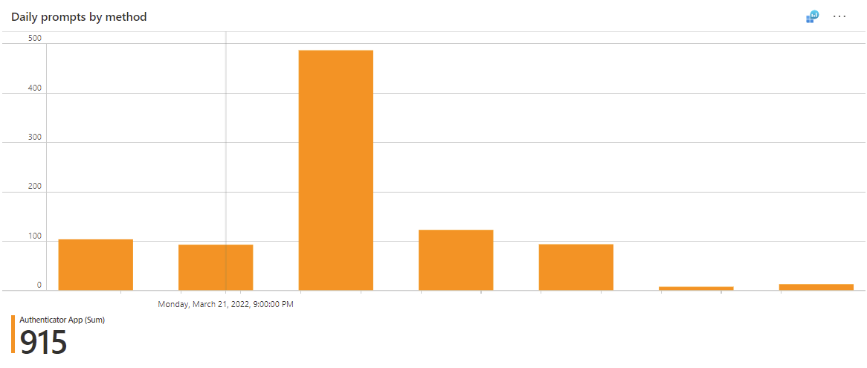
Interactive graphs
SigninLogs
|mv-expand ParsedFields=parse_json(AuthenticationDetails) //parse out Authentication Details column and put in new column called “ParsedFields”
|extend AuthenticationMethod = ParsedFields.authenticationMethod //create new column by extracting the authenticationMethod value out of the ParsedFields column
|extend AuthMethod = tostring(AuthenticationMethod) //convert to string format
|mv-expand ParsedMethod = parse_json(tostring('{SelectedAuthMethod}’)) //parse out SelectedAuthMethod
|extend SelectedAuthMethod = ParsedMethod.series //create new column with by extracting series value
|where SelectedAuthMethod == 'All' or (AuthMethod == SelectedAuthMethod) //parameters for SelectedAuthMethod
|extend ParsedFields2=parse_json(DeviceDetail) //parse out Device Details column and put in column called “ParsedFields2”
|extend DeviceState = case(DeviceDetail["trustType"] == "", "Unmanaged", DeviceDetail["trustType"]) //convert to string
|extend OperatingSystem = ParsedFields2.operatingSystem //extract the operatingSystem value out of the ParsedFields2 column
|extend OS = tostring(OperatingSystem) //convert to string format
|where AuthMethod != "Previously satisfied" and AuthMethod != "“ //remove Previously Satisfied and blank AuthMethods from the query
|where UserDisplayName != "On-Premises Directory Synchronization Service Account“ //remove this UserDisplayDname
|where AuthMethod in ({AuthMethod}) or '*' in ({AuthMethod}) //AuthMethod parameter
|where DeviceState in ({DeviceState}) or '*' in ({DeviceState}) //DeviceState parameter
|where "{User:escape}" == "All users" or UserDisplayName contains "{User:escape}“ //User parameter
|where "{App:escape}" == "All apps" or AppDisplayName contains "{App:escape}“ //App parameter
|where "{OS:escape}" == "All OS" or OS contains "{OS:escape}“ //OS parameter
|extend Status = ParsedFields.succeeded //extract the succeeded valueout of the ParsedFields2 column
|extend AuthStatus = case(Status == "true", "Success", "Failure") //label status as Success or Failure
|where AuthStatus in ({AuthStatus}) or '*' in ({AuthStatus}) //AuthStatus parameter
|summarize AuthMethCount = count() by bin (TimeGenerated, 1d), AuthMethod //aggregate to count the daily sum
By AuthMethod

Slide 38
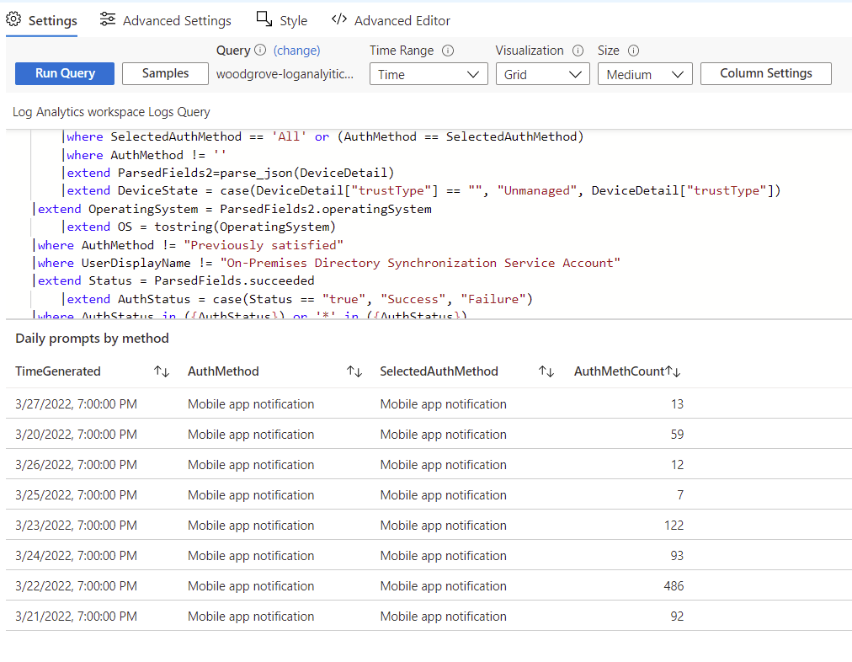
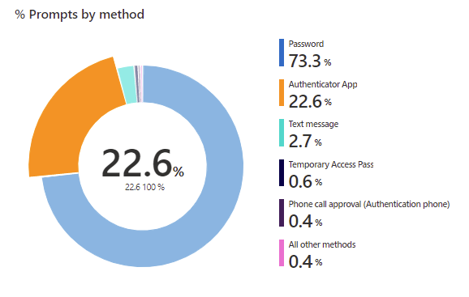
Interactive Graphs

Slide 39
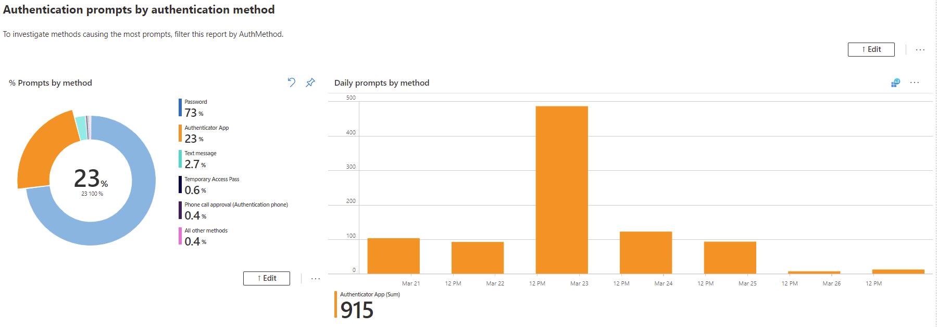
Interactive Graphs

Slide 40
Union

Slide 41
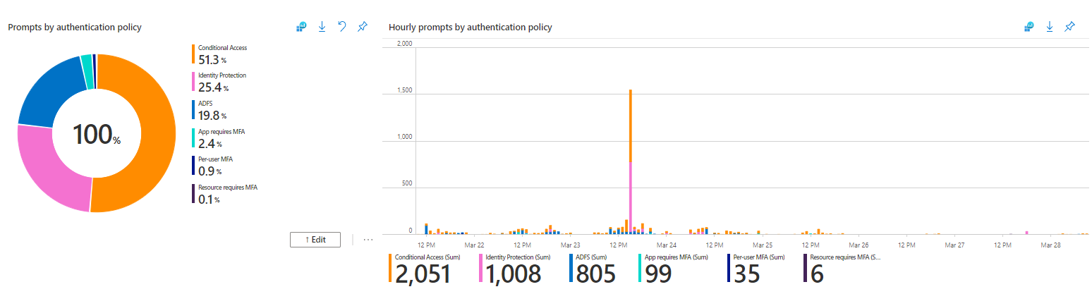
Union of two data sets

Slide 42
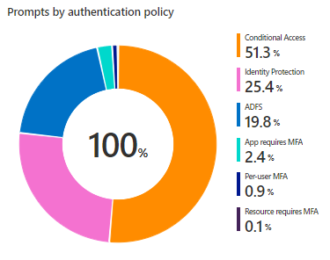
Union of two data sets: the pie chart
let policyData = SigninLogs
|mv-expand ParsedFields=parse_json(AuthenticationDetails)
|extend AuthenticationMethod = ParsedFields.authenticationMethod
|extend AuthMethod = tostring(AuthenticationMethod)
|extend ParsedFields2=parse_json(DeviceDetail)
|extend DeviceState = case(DeviceDetail["trustType"] == "", "Unmanaged", DeviceDetail["trustType"])
|extend OperatingSystem = ParsedFields2.operatingSystem
|extend OS = tostring(OperatingSystem)
|mv-expand ParsedFields3 = parse_json(AuthenticationRequirementPolicies)
|extend AuthReqPolicy = ParsedFields3.detail
|extend AuthPolicy = tostring(AuthReqPolicy)
|where AuthMethod != "Previously satisfied" and AuthMethod != ""
|where UserDisplayName != "On-Premises Directory Synchronization Service Account"
|where AuthMethod in ({AuthMethod}) or '*' in ({AuthMethod})
|where DeviceState in ({DeviceState}) or '*' in ({DeviceState})
|where "{User:escape}" == "All users" or UserDisplayName contains "{User:escape}"
|where "{App:escape}" == "All apps" or AppDisplayName contains "{App:escape}"
|where "{OS:escape}" == "All OS" or OS contains "{OS:escape}"
|extend Status = ParsedFields.succeeded
|extend AuthStatus = case(Status == "true", "Success", "Failure")
|where AuthStatus in ({AuthStatus}) or '*' in ({AuthStatus})
|project AuthPolicy, UserDisplayName, AppDisplayName;
let adfsData = ADFSSignInLogs
|mv-expand PF=parse_json(AuthenticationDetails)
|extend AuthDetail = PF.authenticationMethodDetail
|extend AuthPolicy = tostring(AuthDetail)
|where UserDisplayName != "On-Premises Directory Synchronization Service Account"
|where "{User:escape}" == "All users" or UserDisplayName contains "{User:escape}"
|where "{App:escape}" == "All apps" or AppDisplayName contains "{App:escape}"
|extend Status = PF.succeeded
|extend AuthStatus = case(Status == "true", "Success", "Failure")
|where AuthStatus in ({AuthStatus}) or '*' in ({AuthStatus})
|project AuthPolicy, AuthStatus, AppDisplayName, UserDisplayName;
let basequery = materialize(
union policyData, adfsData
|summarize totalCount = count() by AuthPolicy
);
let total = toscalar(
basequery
| summarize sum(totalCount)
);
basequery
| extend pct = totalCount*100.0/total
Notes:
It’s a lot so let’s break it down into 3 parts

Slide 43
Break it down: First part of the query
let policyData = SigninLogs
|mv-expand ParsedFields=parse_json(AuthenticationDetails) //parse out Authentication Details column and put in new column called “ParsedFields”
|extend AuthenticationMethod = ParsedFields.authenticationMethod //create new column by extracting the authenticationMethod value out of the ParsedFields column
|extend AuthMethod = tostring(AuthenticationMethod) //convert to string format
|extend ParsedFields2=parse_json(DeviceDetail) //parse out Device Details column and put in column called “ParsedFields2”
|extend DeviceState = case(DeviceDetail["trustType"] == "", "Unmanaged", DeviceDetail["trustType"]) //convert to string
|extend OperatingSystem = ParsedFields2.operatingSystem //extract the operatingSystem value out of the ParsedFields2 column
|extend OS = tostring(OperatingSystem) //convert to string format
|mv-expand ParsedFields3 = parse_json(AuthenticationRequirementPolicies)
|extend AuthReqPolicy = ParsedFields3.detail
|extend AuthPolicy = tostring(AuthReqPolicy)
|where AuthMethod != "Previously satisfied" and AuthMethod != "“ //remove Previously Satisfied and blank AuthMethods from the query
|where UserDisplayName != "On-Premises Directory Synchronization Service Account“ //remove this UserDisplayDname
|where AuthMethod in ({AuthMethod}) or '*' in ({AuthMethod}) //AuthMethod parameter
|where DeviceState in ({DeviceState}) or '*' in ({DeviceState}) //DeviceState parameter
|where "{User:escape}" == "All users" or UserDisplayName contains "{User:escape}“ //User parameter
|where "{App:escape}" == "All apps" or AppDisplayName contains "{App:escape}“ //App parameter
|where "{OS:escape}" == "All OS" or OS contains "{OS:escape}“ //OS parameter
|extend Status = ParsedFields.succeeded //extract the succeeded valueout of the ParsedFields2 column
|extend AuthStatus = case(Status == "true", "Success", "Failure") //label status as Success or Failure
|where AuthStatus in ({AuthStatus}) or '*' in ({AuthStatus}) //AuthStatus parameter
|project TimeGenerated, AuthPolicy, UserDisplayName, AppDisplayName; //Select columns
Notes:
Policy data is now basically a table of the TimeGen, Auth Policy, User Display Name and App Display Name
The Project Operator -Select the columns to include, rename or drop, and insert new computed columns.
The order of the columns in the result is specified by the order of the arguments. Only the columns specified in the arguments are included in the result. Any other columns in the input are dropped. See also extend.

Slide 44
Break it down: Second part of the query
let adfsData = ADFSSignInLogs //store a dataset in adfsData
|mv-expand PF=parse_json(AuthenticationDetails) //parse out AuthenticationDetails column and put in new column called “PF”
|extend AuthDetail = PF.authenticationMethodDetail //create new column by extracting the authenticationMethodDetail value out of the PF column
|extend AuthPolicy = tostring(AuthDetail) //convert to string format
|where UserDisplayName != "On-Premises Directory Synchronization Service Account"
|where "{User:escape}" == "All users" or UserDisplayName contains "{User:escape}“ //User parameter
|where "{App:escape}" == "All apps" or AppDisplayName contains "{App:escape}“ //App parameter
|extend Status = PF.succeeded //extract status from the succeeded value in the PF column
|extend AuthStatus = case(Status == "true", "Success", "Failure") // if true, return “Success”, if not, return Failure
|where AuthStatus in ({AuthStatus}) or '*' in ({AuthStatus}) //AuthStatus parameter
|project TimeGenerated,AuthPolicy, AuthStatus, AppDisplayName, UserDisplayName; //Select columns
Notes:
Now we are going to pull in the ADFS Data itself is a type of policy that we want to observe in this visualization
Not all the same parameters can apply
Case = Evaluates a list of predicates and returns the first result expression whose predicate is satisfied.
If neither of the predicates return true, the result of the last expression (the else) is returned. All odd arguments (count starts at 1) must be expressions that evaluate to a boolean value. All even arguments (the thens) and the last argument (the else) must be of the same type.
range Size from 1 to 15 step 2 | extend bucket = case(Size <= 3, "Small", Size <= 10, "Medium", "Large")

Slide 45
Break it down: Third part of the query
let baseQuery = materialize( //store a dataset in baseQuery
union policyData, adfsData //bring together the first and second query
|summarize totalCount = count() by AuthPolicy); //aggregate count by Auth Policy and close the let statement
let total = //calculate total of baseQuery
toscalar(baseQuery //toscalar will return a constant value of the evaluated expression
| summarize sum(totalCount)); //the evaluated expression totalCount by Auth Policy and close the let statement
baseQuery
| extend pct = totalCount*100.0/total //create new column showing percentage of totalCount
Notes:
Now we are going to pull in the ADFS Data itself is a type of policy that we want to observe in this visualization
Not all the same parameters can apply
Case = Evaluates a list of predicates and returns the first result expression whose predicate is satisfied.
If neither of the predicates return true, the result of the last expression (the else) is returned. All odd arguments (count starts at 1) must be expressions that evaluate to a boolean value. All even arguments (the thens) and the last argument (the else) must be of the same type.
range Size from 1 to 15 step 2 | extend bucket = case(Size <= 3, "Small", Size <= 10, "Medium", "Large")

Slide 46
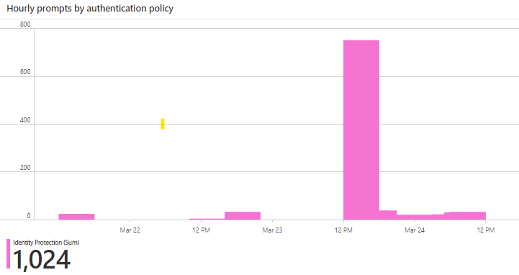
Union of two data sets: the bar chart
let policyData = SigninLogs
|mv-expand ParsedFields=parse_json(AuthenticationDetails)
|extend AuthenticationMethod = ParsedFields.authenticationMethod
|extend AuthMethod = tostring(AuthenticationMethod)
|extend ParsedFields2=parse_json(DeviceDetail)
|extend DeviceState = case(DeviceDetail["trustType"] == "", "Unmanaged", DeviceDetail["trustType"])
|extend OperatingSystem = ParsedFields2.operatingSystem
|extend OS = tostring(OperatingSystem)
|mv-expand ParsedFields3 = parse_json(AuthenticationRequirementPolicies)
|extend AuthReqPolicy = ParsedFields3.detail
|extend AuthPolicy = tostring(AuthReqPolicy)
| mv-expand ParsedPolicy = parse_json(tostring('{SelectedPolicy}'))
| extend SelectedPolicy = ParsedPolicy.series
| where SelectedPolicy == 'All' or (AuthPolicy == SelectedPolicy)
|where AuthMethod != "Previously satisfied" and AuthMethod != ""
|where UserDisplayName != "On-Premises Directory Synchronization Service Account"
|where AuthMethod in ({AuthMethod}) or '*' in ({AuthMethod})
|where DeviceState in ({DeviceState}) or '*' in ({DeviceState})
| where "{User:escape}" == "All users" or UserDisplayName contains "{User:escape}"
| where "{App:escape}" == "All apps" or AppDisplayName contains "{App:escape}"
| where "{OS:escape}" == "All OS" or OS contains "{OS:escape}"
|extend Status = ParsedFields.succeeded
|extend AuthStatus = case(Status == "true", "Success", "Failure")
|where AuthStatus in ({AuthStatus}) or '*' in ({AuthStatus})
|project TimeGenerated, AuthPolicy, UserDisplayName, AppDisplayName;
let adfsData = ADFSSignInLogs
|mv-expand PF=parse_json(AuthenticationDetails)
|extend AuthDetail = PF.authenticationMethodDetail
|extend AuthPolicy = tostring(AuthDetail)
| mv-expand ParsedPolicy = parse_json(tostring('{SelectedPolicy}'))
| extend SelectedPolicy = ParsedPolicy.series
| where SelectedPolicy == 'All' or (AuthPolicy == SelectedPolicy)
|where UserDisplayName != "On-Premises Directory Synchronization Service Account"
| where "{User:escape}" == "All users" or UserDisplayName contains "{User:escape}"
| where "{App:escape}" == "All apps" or AppDisplayName contains "{App:escape}"
|extend Status = PF.succeeded
|extend AuthStatus = case(Status == "true", "Success", "Failure")
|where AuthStatus in ({AuthStatus}) or '*' in ({AuthStatus})
|project TimeGenerated,AuthPolicy, AuthStatus, AppDisplayName, UserDisplayName;
union policyData, adfsData
|summarize Count = count() by bin(TimeGenerated,1h),AuthPolicy
Notes:
The bar chart is very similar to the pie chart query – maybe even a bit more straightforward
We are still creating the two data sets, but this time we can just do a simple union and then summarize the count on a hourly basis by auth policy.

Slide 47
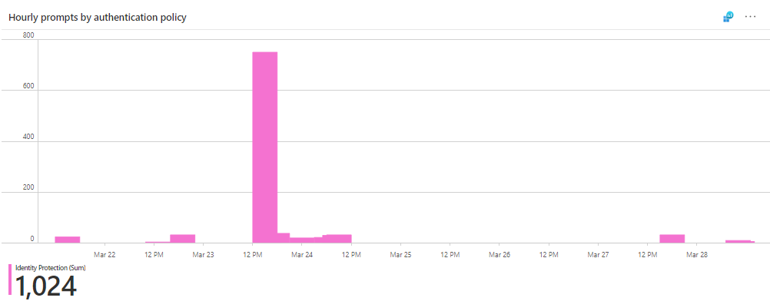
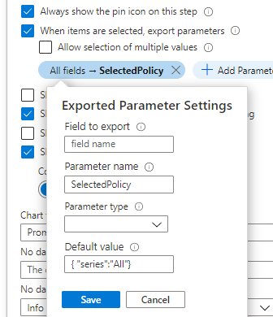
The bar chart is still interactive…
| mv-expand ParsedPolicy = parse_json(tostring('{SelectedPolicy}'))
| extend SelectedPolicy = ParsedPolicy.series
| where SelectedPolicy == 'All' or (AuthPolicy == SelectedPolicy)
Notes:
We still want the pie and bar chart to be interactive, so don’t forget that we have to add the exported parameter settings in the pie chart, and these extra lines to the bar chart query.

Slide 48
Union of two data sets

Slide 49

Community Contribution

Slide 50
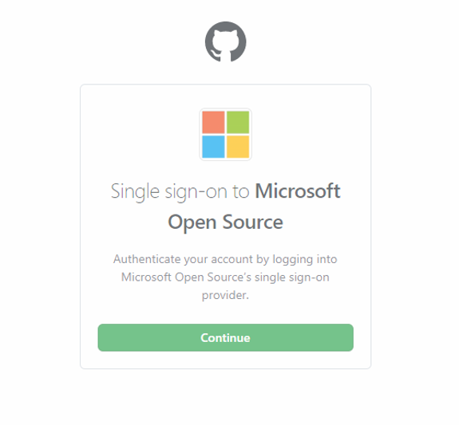
Join the Azure AD Workbooks community on GitHub​
Submit your ideas
Create your own workbook
Help others improve their feedback
Share tips and tricks
Notes:
Help me figure out how to make the map interactive

Slide 51
More resources at aka.ms/KQLBlueTeam
Azure Monitor Workbooks Overview​ – great starting place when learning about workbooks
Configure a Log Analytics Workspace – if you don’t already have a LA workspace, use this tutorial to set one up
How to use Azure AD workbooks ​ - a brief write-up about most of the workbooks in the gallery
Microsoft Organization in GitHub and @azure-ad-workbooks ​– join this GitHub Repo and team to learn much more about Azure AD Workbooks as well as to contribute.
Kusto Query Language (KQL) from Scratch​ – great Pluralsight Tutorial for learning KQL
aka.ms/PreviewWorkbooks ​– see Azure AD Workbooks in private preview!

Slide 52
Q&A

Slide 53

Thank you!
Stay in touch:
Corissa Koopmans | @Corissalea
Tosin Lufadeju | @TosinLuf_PM

Slide 54
Thank You!

Slide 55
Appendix

Slide 56


